Slide 1
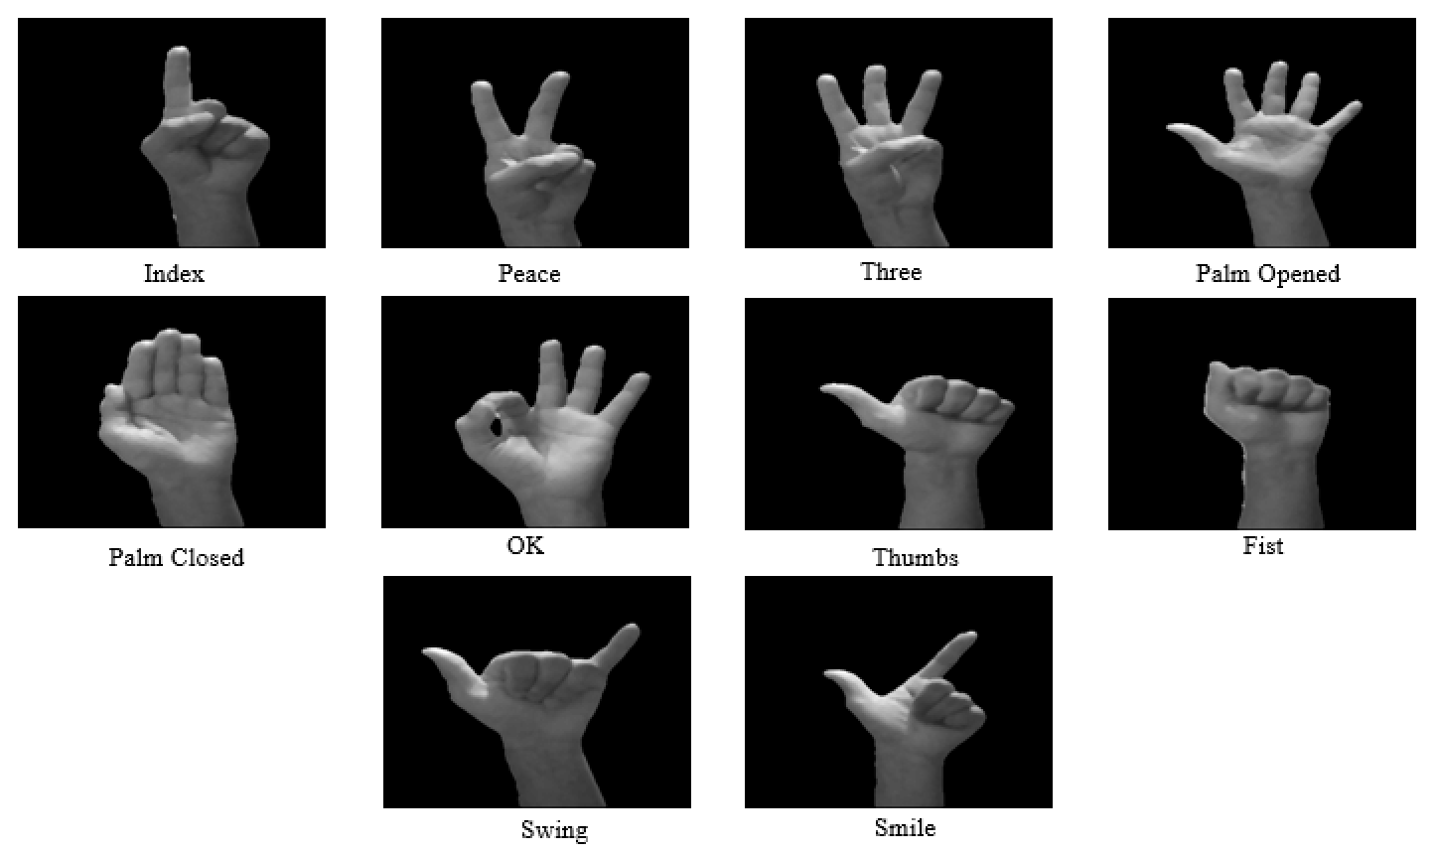
REAL-TIME SIGN LANGUAGE DETECTION BASED ON YOLO
SHU WANYANG
YAN JIAHUAN
XIAO CHANGWEI
Notes:
Good afternoon everyone, I’m shu wanyang from Group 13. The topic of our group project is REAL-TIME SIGN LANGUAGE DETECTION BASED ON YOLOv3.

Slide 2
Background
How many deaf people in Singapore?
Notes:
The first part of our presentation is about the background of deaf culture.First, let’s start with a question. How many deaf people do you think in Singapore?

Slide 3
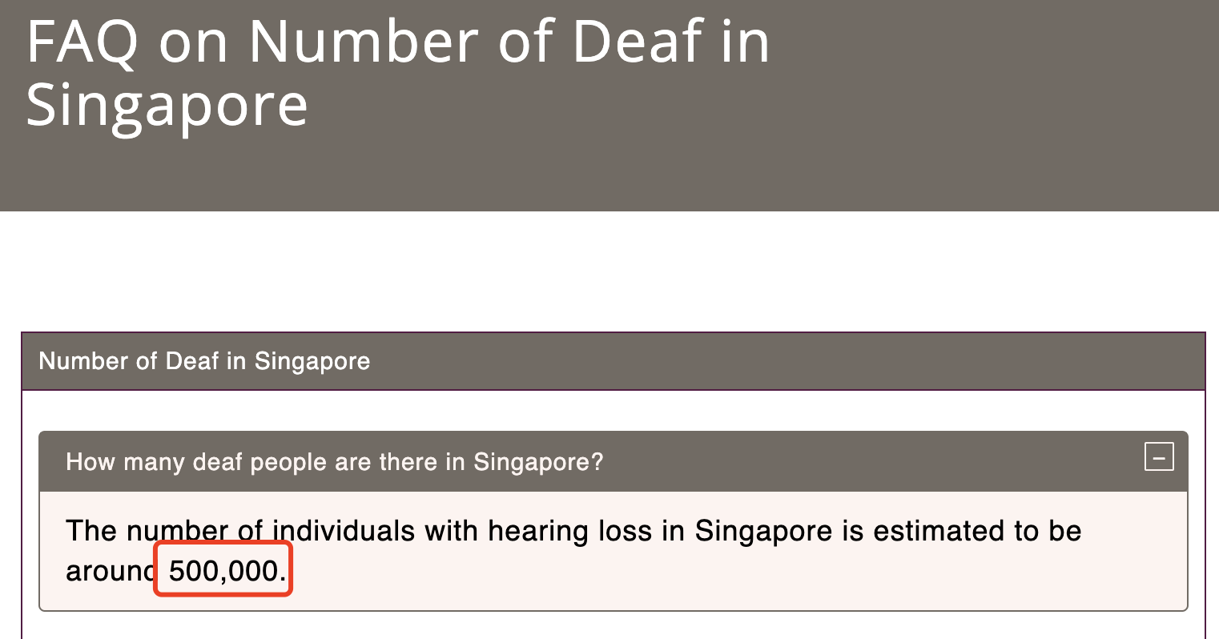
Background
How many deaf people in Singapore?
Notes:
The number is very amazing. From the website of sadeaf, we found that the number of people in singapore with hearing loss is about 500000. These people could only communicate in sign language.

Slide 4
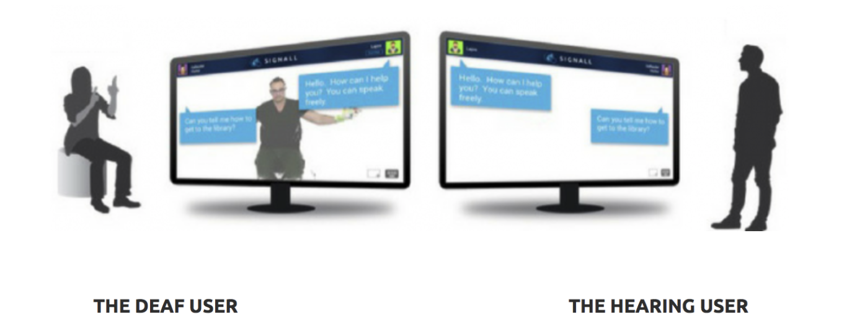
Aim
Notes:
Considering such a large number of people in our society are suffering from the problem of communication between deaf people and hearing people. What we expected to create is a real-time sign language detection system by only using the camera of your computer to serve as a bridge between deaf people and hearing people

Slide 5
Scenarios
Video Capture
Hand Detection
Feature Extraction
Neural Network
Text Output
Notes:
The simple scenarios is like this First we capture the picture from the video chat and then detect the hand, extract the feature, translate by neural network and at last output the meaning of sign language.

Slide 6
Scenarios
Video Capture
Hand Detection
Feature Extraction
Neural Network
Text Output
How to capture the picture from the real-time video chat?
How to recognize the meaning of sign language from the picture?
Notes:
In this scenarios, we have two main problem. How to capture the picture from the real-time video chat? and How to recognize the meaning of sign language from the picture?
In next part, we will have changwei to introduce how to conquer the first problem.

Slide 7
Subgoal 1:Get real-time images from the camera

Slide 8

What is OpenCV?
OpenCV is a cross-platform computer vision and machine learning software library. It has played an important role in the development of computer vision. In 1999, Gary, who worked at Intel, released OpencV, which was written in C and C++ at the time. Now, it can work in python, java and matlab.

Slide 9
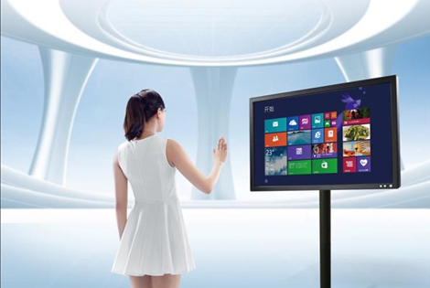
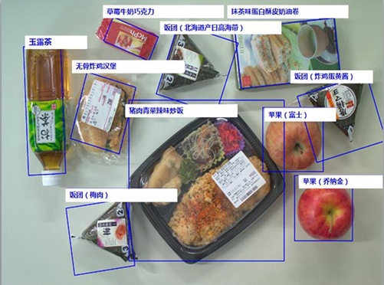
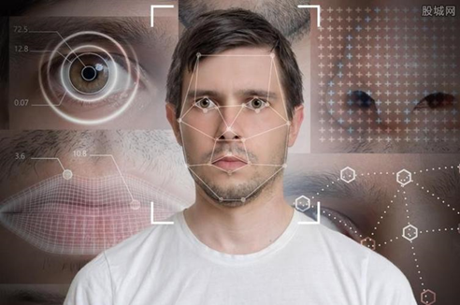
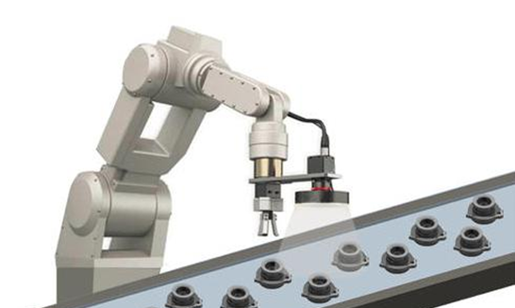
What can OpenCV do?
human-computer interaction
object recognition
machine vision
face recognition

Slide 10
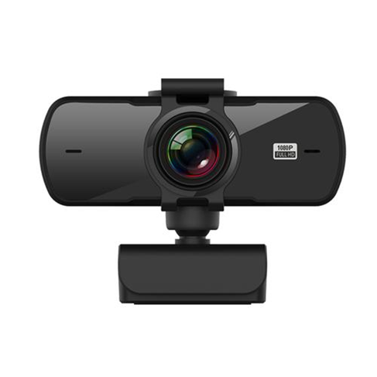
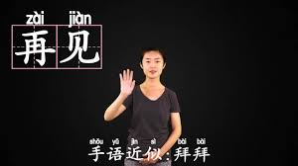

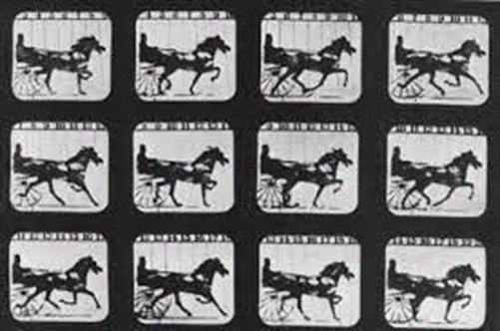
How to get key frames?
Real-time video
Call the camera with a function
Divide video into several key frames
Hand position recognition
OpenPose

Slide 11
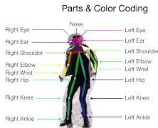
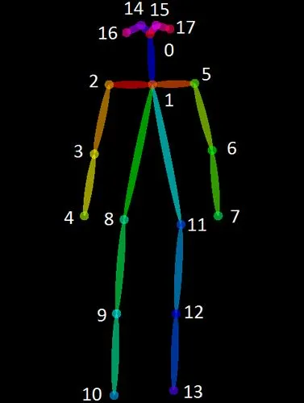
What is OpenPose?
OpenPose is used for human pose recognition, which can realize posture estimation of human movements, facial expressions, finger movements and so on. OpenPose can extract the desired hand position from the human image.

Slide 12
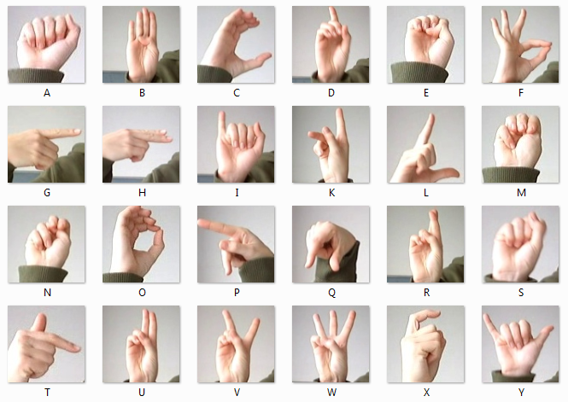
Subgoal 2: Hand gesture interpretation modeling
?
Assume it is our model.
This is a graphic demonstration of American Sign Language (ASL).
Source from Kaggle sign-MNIST
Notes:
The subgoal 2 here answers the question aforementioned like : how to recognize the hand gensture ?
so basicly we want to build a model to translate the sign language to nature languages everyone can understand.
To be more specific, To build a robust model that can recognize specific sign language to a certain level of accuracy in complex environments. At the same time, the model should be lightweight so that it can be implanted in mobile devices as phones and tablets.

Slide 13
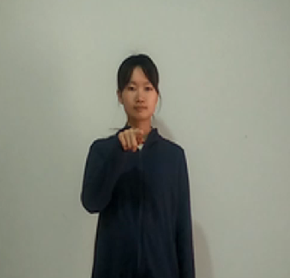
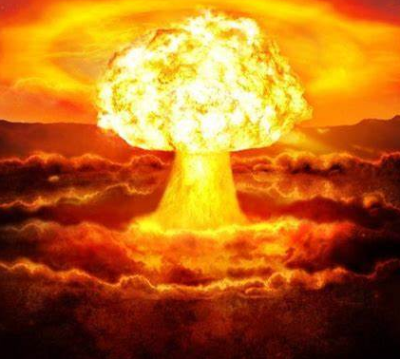
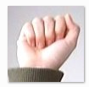
What do we need?
Object Targeting
Background Noise Elimination
We need a robust and outstanding deep learning model!
Notes:
Sign language recognition is not a new task, researchers have been studying it over years, and in most experiments, they will use machine learning methods. But according to our research, Conventional machine learning architectures meet the challenges in practical sign language recognition, as the models' ability of interpretation will be weakened when the semantics in sign language becomes rich and the range of subjects' motions become small. Hence, the structured deep neural network is implemented to overcome the limitations in previous sign language recognition tasks. The millions of artificial neurons will automatically find ways to identify the details in every pixel and jointly ouput the most reliable result.

Slide 14
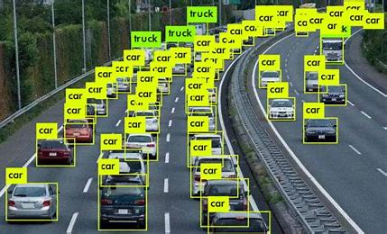
What is YOLOv3?
YOLOv3 (You only look once)
A structured deep neural network composed of Conv2D, Residual_Block
An algorithm that applies upsampling and transposed convolution mechanism to return the image data with frame and label
Notes:
Based on above consideration, we introduce YOLOv3 algorithm to our project, and use it as our network sturcture.
So what is YOLOv3?
YOLOv3 is a real time object detection algorithm that can identify certain object on image, video or live feeds. YOLO is trained to do classification and bounding box regression at the same time, which means it will not only identify the target's class, but also locate the targrts on the image and segment each by using boundary boxes or anchor boxes.

Slide 15
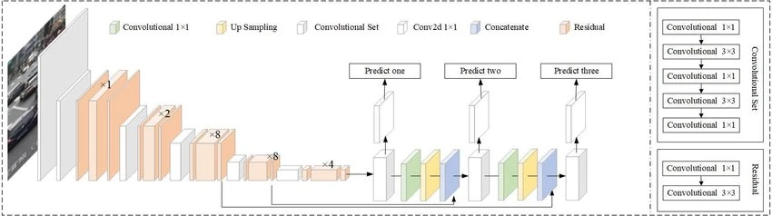
Why YOLOv3?
It has a balanced classification performance on both the detection accuracy and speed.
YOLOv3 algorithm can delimit borders of the targeted objects and make predictions on every region.
Structure detail of YOLOv3.It uses Darknet-53 as the backbone network and uses three scale predictions.
Source from mini-YOLOv3: Real-Time Object Detector for Embedded Applications
Notes:
The next question is why use YOLOv3?
well, if you look at the stucture in this graph. You will find some convlution layer and residual block there, so as a NN, it is good at feature extraction at high level dimension. Also, YOLOv3 can delimit borders of the targrted objects and make predictions on every region. We really need target location function when the scenario becomes chaos and complex.

Slide 16
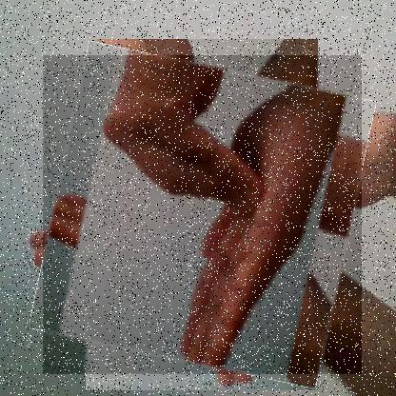
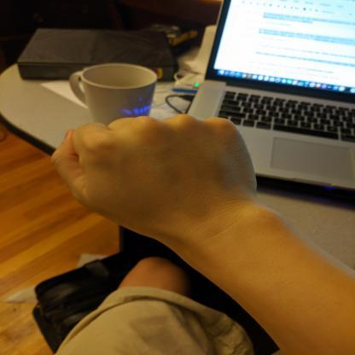
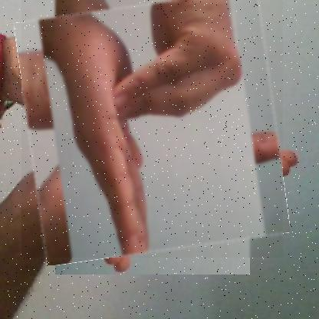
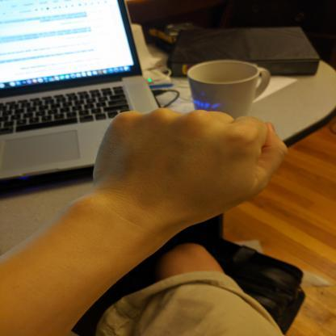
More “Z”, less “A”?
Current Progress
Counteract the imbalance
Label:
25
0.5096153846153846 0.5432692307692307 0.8076923076923077 0.8076923076923077
Label:
0 0.5600961538461539 0.4879807692307692 0.6201923076923077 0.3653846153846153
height
(x,y)
(w,h)
width
Label:
25 0.4783653846153846 0.4050480769230769 0.8221153846153846 0.8100961538461539
Label:
0 0.4399038461538461 0.4879807692307692 0.6201923076923077 0.3653846153846153
Data augmentation from ASL dataset and relabeling
Data collection and labeling from our own
Notes:
And lets see what we have done so far. Basically the dataset collection, we can't find much gold-standard dataset for YOLOv3, so we relebel the dataset from Kaggle-MNIST, which is actually an American Sign language dataset for classification task. we add the absolute location information of center point and the length and width of the boundary box. And also, we found the dataset inbalance in original dataset, hence we collect some dataset and relable it in the same way to counteract the imbalance.

Slide 17
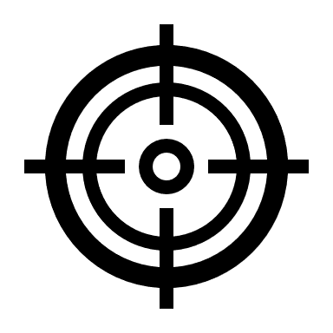



What do we want to achieve?
Build a robust and outstanding sign language recognition model.
Use YOLOv3 and other algorithms to shorter the response time.
Help people with speaking disorders to have better daily communication experience.

Slide 18
Q&A
Thank you for your attention.

